Slide 1
ENSE 400 Nov.23 Mid-Scrum
SoundByte
Brandon Clarke, Mason Lane, Jiwoun Kim
23/11/2020

Slide 2
What We’re Doing
Our team will provide creators & hobbyists with a tool that prescribes audio files to complement a given song when mixing. The goal is to improve the workflow of artists while being a utility for DJs in the future.

Slide 3
Roles and Responsibilities
Brandon Clarke:
ML component. Science, Research, Development
Jiwoun Kim:
frontend design & development
backend development
Mason Lane
Scrum Master
backend/frontend architecture
backend development
ML advisory

Slide 4
What Have We Been Up To?

Slide 5
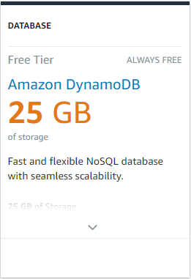
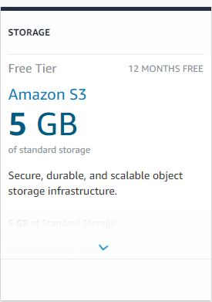
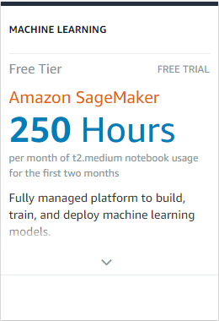
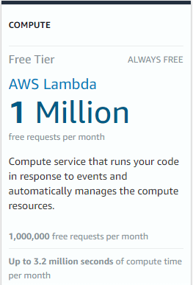
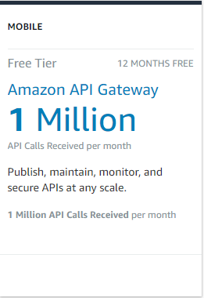
Technology
We’ve opted to use the following as our backend
AWS Lambda will handle requests. Mainly controller logic as it sends queries to the model/db.
We will be looking into AWS sagemaker, but may instead run our model from Lambda as well
Using dynamoDB. We do not expect to need a relational database. Although, it would have been good for scalability
To make communication between our front-end & AWS Lambda easier & secure, we will also consider leveraging AWS API Gateway.
We will need amazon s3 if we are to support playback. Otherwise, perhaps we could integrate spotify.
S3 for temp storage if we find it hard to keep below the 512mb cap.
connecting amplify->gateway->lambda->dynamo: https://master.d1l8qoo3axmsxd.amplifyapp.com/

Slide 6
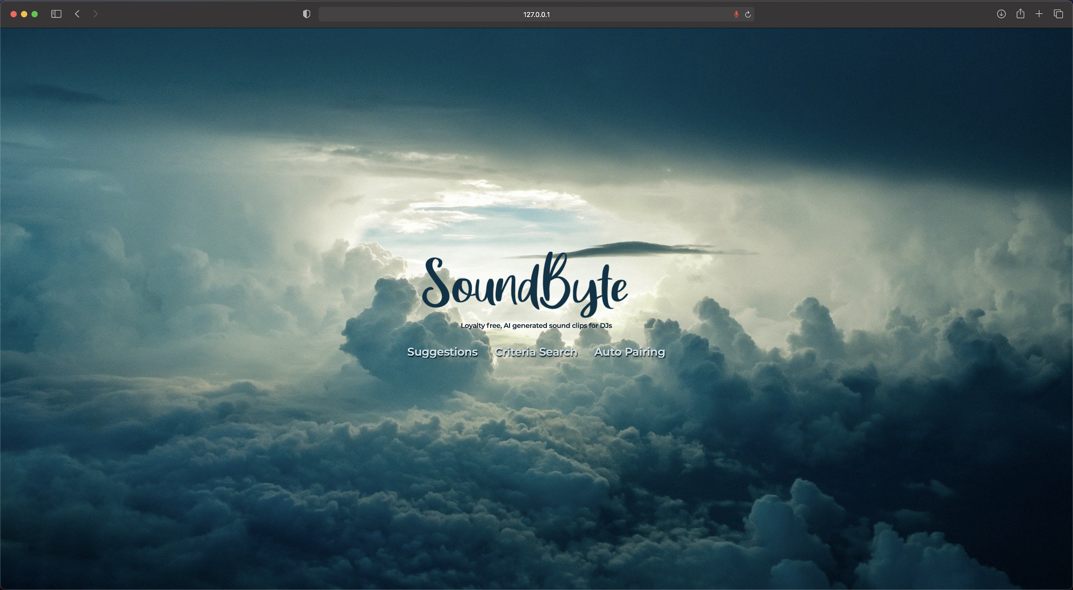
Front-end
Landing page is completed in html, css, and javascript

Slide 7
Machine Learning
Will be using jupyter notebook for the machine learning platform
Researching and playing with feature extraction
Small misunderstanding of where to start

Slide 8
Risks
Lambda has a 512mb hard limit across all requests.
We need to consider switching to elastic beanstalk or other compute services. Lambda may not be a good option if many users are uploading 5mb songs.
Mentor Opinion?
S3 free tier storage is only 5gb.
We need to consider paying for more space, switching services, or devising some kind of solution with spotify/other.
While moving to services has offloaded much of the workload, it has introduced various complications we will need to overcome and strategize for

Slide 9
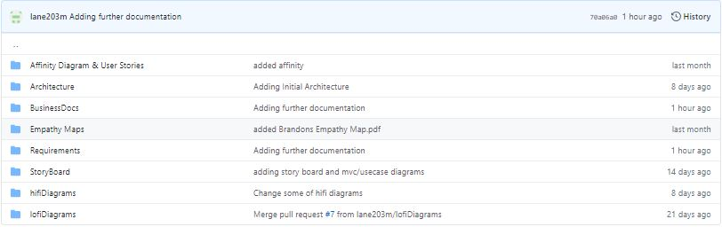
Further Documentation Available

Slide 10
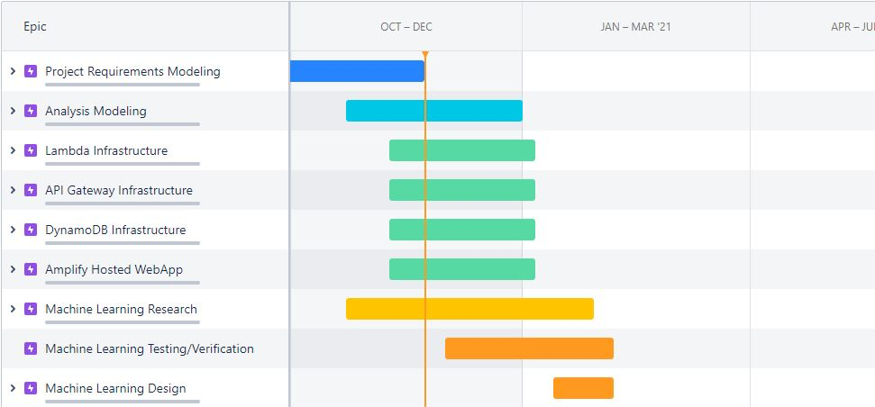
Moving to Jira
https://soundbyte.atlassian.net/jira/software/projects/SB/boards/1/roadmap?selectedIssue=SB-22&shared=&atlOrigin=eyJpIjoiYWFhZDJiZjQ1OGQzNGMxOWI5ZDVjZjI3MjkxNTdhOWQiLCJwIjoiaiJ9

Slide 11
Whats next?
Brandon to continue work on ML component.
Extracting features,
training a model,
manipulating our dataset & deriving new features
Jiwoun & Mason to work on frontend/backend
Delving into our backend:
Further develop ApiGateway, Lambda, DynamoDB
Integrate S3
Consider exploring elastic beanstalk as an alternative
Handle simple requests from the front-end
Next, building a front-end to communicate with backend
UI Development
Transition to React as the front end framework(if possible)
Re-evaluate/define story mapping.
Create Dataflow/Communication Diagrams
Sequence Diagrams if needed.
Risk assessment & mitigation docs. QA docs.

Slide 12
What’s Missing/Behind?
Things To Remember
We have some design issues being caused by our inexperience with AWS services. We are doing our best to discover and address limitations before they go too unnoticed.
Website/Landing for stakeholders & faculty. An area for you to meet us & the project as suggested by Tim
We have many design documents. However, architecture will change as we progress. If we change a document/class, we should remember to update past documents that lead to that conclusion

Slide 13
Group reflection
Do you feel you are on track?
We will need to spend some time ensuring the services we’ve chosen will scale as expected. If we do not plan properly, we may find ourselves taking some steps backward.
Do you feel there are barriers to your success (if any)?
As stated, aws has introduced some requirements we had not foreseen.
Do you need any help going forward?
Advice on our upcoming risk assessment & mitigation solutions.
Any other questions or concerns?
Would love commentary on architecture. How are we doing?

Slide 14

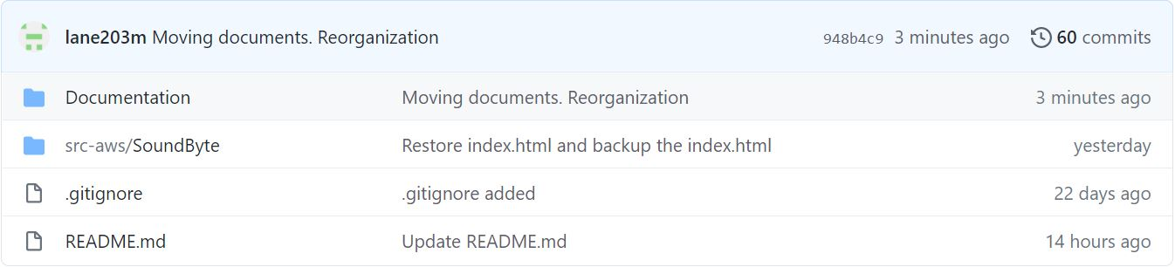
Github
https://github.com/lane203m/SoundByte

